Slide 1
The Importance of Being Earnest
Costume Design Research

Slide 2
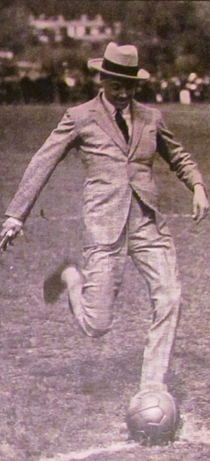
John Worthing

Slide 3
Gwendolen Fairfax

Slide 4
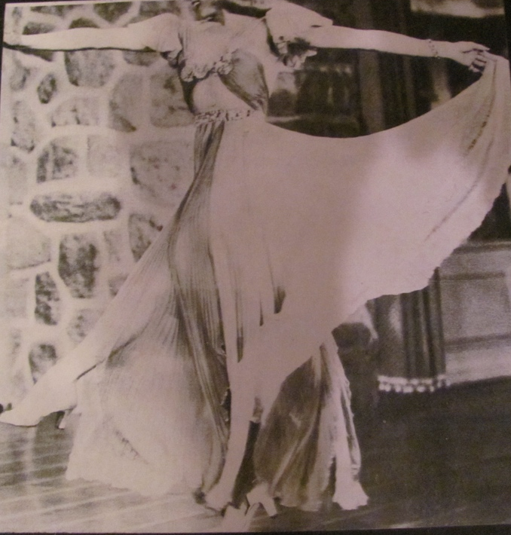
Cecily Cardew

Slide 5
Algernon Moncrieff

Slide 6
Lady Bracknell

Slide 7
Miss Prism

Slide 8
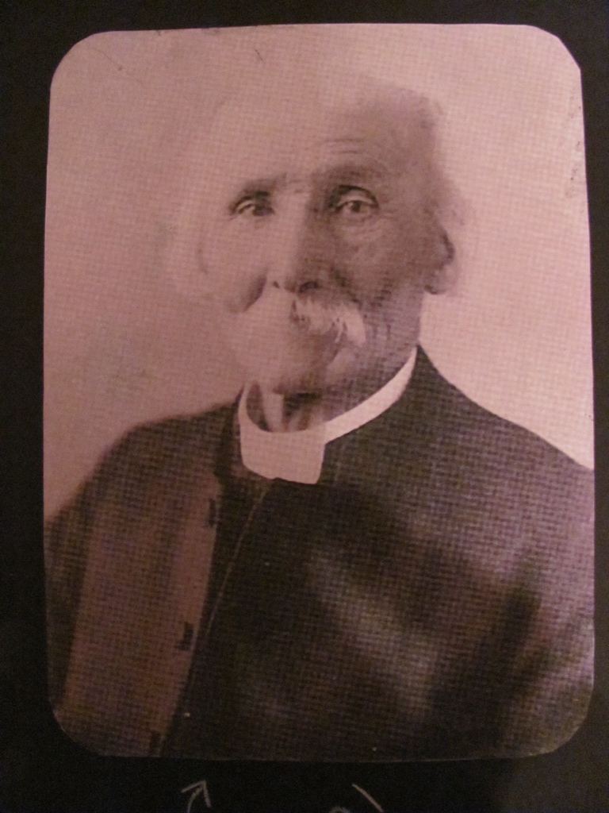
Dr. Chasuble

